Slide 1
Using Subqueries to Solve Queries
7

Slide 2
Objectives
After completing this lesson, you should be able to do the following:
Define subqueries
Describe the types of problems that the subqueries can solve
List the types of subqueries
Write single-row and multiple-row subqueries

Slide 3
Lesson Agenda
Subquery: Types, syntax, and guidelines
Single-row subqueries:
Group functions in a subquery
HAVING clause with subqueries
Multiple-row subqueries
Use ALL or ANY operator.
Using the EXISTS operator
Null values in a subquery

Slide 4

Using a Subquery to Solve a Problem
Who has a salary greater than Abel’s?
Main query:
Which employees have salaries greater than Abel’s salary?
Subquery:
What is Abel’s salary?

Slide 5
Subquery Syntax
SELECT FROM WHERE
select_list table
expr operator
(SELECT FROM
select_list table);
The subquery (inner query) executes before the main query (outer query).
The result of the subquery is used by the main query.

Slide 6
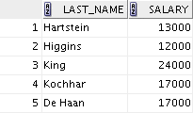
Using a Subquery
SELECT last_name, salary FROM employees
WHERE salary > 11000
(SELECT salary
FROM WHERE
employees
last_name = 'Abel');

Slide 7
Guidelines for Using Subqueries
Enclose subqueries in parentheses.
Place subqueries on the right side of the comparison condition for readability. (However, the subquery can appear on either side of the comparison operator.)
Use single-row operators with single-row subqueries and multiple-row operators with multiple-row subqueries.

Slide 8
Types of Subqueries
Single-row subquery
Main query |  |  | returns
 | Subquery
ST_CLERK
Multiple-row subquery
Main query
Subquery
returns
ST_CLERK SA_MAN

Slide 9
Single-Row Subqueries
Return only one row
Use single-row comparison operators
Operator | Meaning
= | Equal to
> | Greater than
>= | Greater than or equal to
< | Less than
<= | Less than or equal to
<> | Not equal to

Slide 10

Executing Single-Row Subqueries
SELECT last_name, job_id, salary
FROM WHERE
employees job_id =
(SELECT job_id
SA_REP
employees
last_name = 'Taylor')
8600
(SELECT salary
FROM WHERE
AND
salary >
FROM employees
WHERE last_name = 'Taylor');

Slide 11

Using Group Functions in a Subquery
SELECT last_name, job_id, salary
FROM employees WHERE salary =
2500
(SELECT MIN(salary) FROM employees);

Slide 12
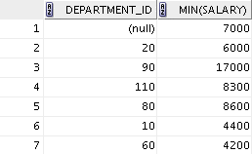
HAVING Clause with Subqueries
The Oracle server executes the subqueries first.
The Oracle server returns results into the HAVING clause of the main query.
SELECT FROM
department_id, MIN(salary) employees
GROUP BY department_id
2500
(SELECT MIN(salary)
HAVING MIN(salary) >
FROM employees
WHERE department_id = 50);

Slide 13
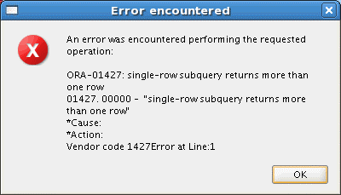
What Is Wrong with This Statement?
SELECT employee_id, last_name FROM employees
WHERE =
salary
(SELECT FROM
MIN(salary) employees
GROUP BY department_id);
Single-row operator with multiple-row subquery

Slide 14
No Rows Returned by the Inner Query
SELECT last_name, job_id FROM employees
WHERE job_id =
(SELECT job_id
FROM WHERE
employees
last_name = 'Haas');
Subquery returns no rows because there is no employee named “Haas.”

Slide 15
Multiple-Row Subqueries
Return more than one row
Use multiple-row comparison operators
Operator | Meaning
IN | Equal to any member in the list
ANY | Must be preceded by =, !=, >, <, <=, >=. Compares a value to each value in a list or returned by a query. Evaluates to FALSE if the query returns no rows.
ALL | Must be preceded by =, !=, >, <, <=, >=. Compares a value to every value in a list or returned by a query. Evaluates to TRUE if the query returns no rows.

Slide 16
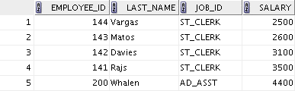

Using the ANY Operator in Multiple-Row Subqueries
SELECT employee_id, last_name, job_id, salary
FROM WHERE
employees salary <
9000, 6000, 4200
ANY
(SELECT salary FROM employees
WHERE job_id = 'IT_PROG') job_id <> 'IT_PROG';
AND
…

Slide 17

Using the ALL Operator in Multiple-Row Subqueries
SELECT employee_id, last_name, job_id, salary
FROM WHERE
employees salary <
9000, 6000, 4200
ALL
(SELECT salary FROM employees
WHERE job_id = 'IT_PROG') job_id <> 'IT_PROG';
AND

Slide 18
Using the EXISTS Operator
SELECT * FROM departments WHERE NOT EXISTS
(SELECT * FROM employees
WHERE employees.department_id=departments.department_id);

Slide 19
Summary
In this lesson, you should have learned how to:
Identify when a subquery can help solve a problem
Write subqueries when a query is based on unknown values
SELECT FROM WHERE
select_list table
expr operator
(SELECT select_list
FROM table);

Slide 20
Practice 7: Overview
This practice covers the following topics:
Creating subqueries to query values based on unknown criteria
Using subqueries to find out the values that exist in one set of data and not in another

